Slide 1
ONLINE CLASS
GRAPH THEORY
BICTE $6^{TH}$ SEMESTER
2078/03/22
PRESENTED BY KALYAN DAHAL

Slide 2
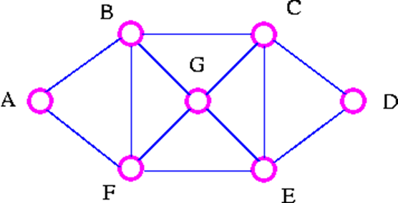
Euler Graphs
Consider the following road map
The explorer's Problem: An explorer wants to explore all the routes between a number of cities. Can a tour be found which traverses each route only once? Particularly, find a tour which starts at A, goes along each road exactly once, and ends back at A.

Slide 3

Continued….
Examples of such tour are
The Explorer travels along each road (edges) just once but may visit a particular city (vertex) several times.
The Traveler's Problem
A traveler wants to visit a number of cities. Can a tour be found which visits each city only once? Particularly, find a tour which starts at A, goes to each city exactly once, and ends back at A.

Slide 4
Continued….
Examples of such tour are
A B C D E G F A
A F E D C G B A
The travelers visit each city (vertex) just once but may omit several of the roads (edges) on the way.
Eulerian Trail:
A connected graph G is Eulerian if there is a closed trail which includes every edge of G, such a trail is called a Eulerian trail.

Slide 5
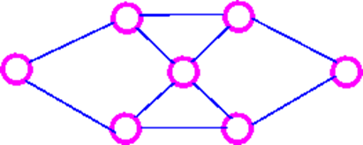
Hamiltonian Cycle
A connected graph G is Hamiltonian if there is a cycle which includes every vertex of G; such a cycle is called a Hamiltonian cycle.
Consider the following examples:
This graph is BOTH Eulerian and Hamiltonian.

Slide 6
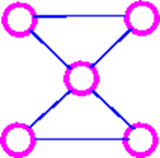
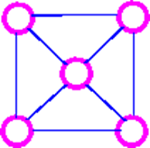
Continued….
This graph is Eulerian, but NOT Hamiltonian.

Slide 7
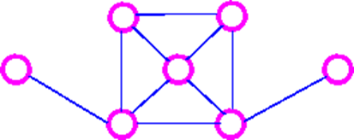
Continued….
This graph is a Hamiltonian, but NOT Eulerian.
This graph is NEITHER Eulerian NOR Hamiltonian

Slide 8
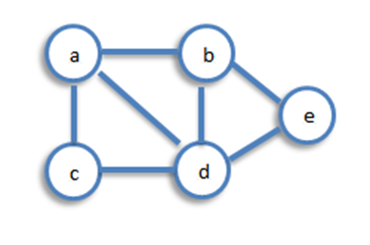
Connectivity
A graph is said to be connected if there is a path between every pair of vertex. From every vertex to any other vertex, there should be some path to traverse. That is called the connectivity of a graph. A graph with multiple disconnected vertices and edges is said to be disconnected.
Example 1: In the following graph, it is possible to travel from one vertex to any other vertex. For example, one can traverse from vertex ‘a’ to vertex ‘e’ using the path ‘a-b-e’.

Slide 9
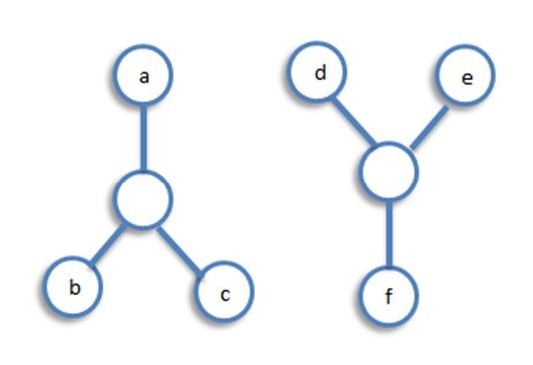
Continued…
Example 2: In the following example, traversing from vertex ‘a’ to vertex ‘f’ is not possible because there is no path between them directly or indirectly. Hence it is a disconnected graph.

Slide 10
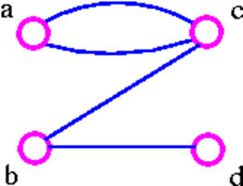
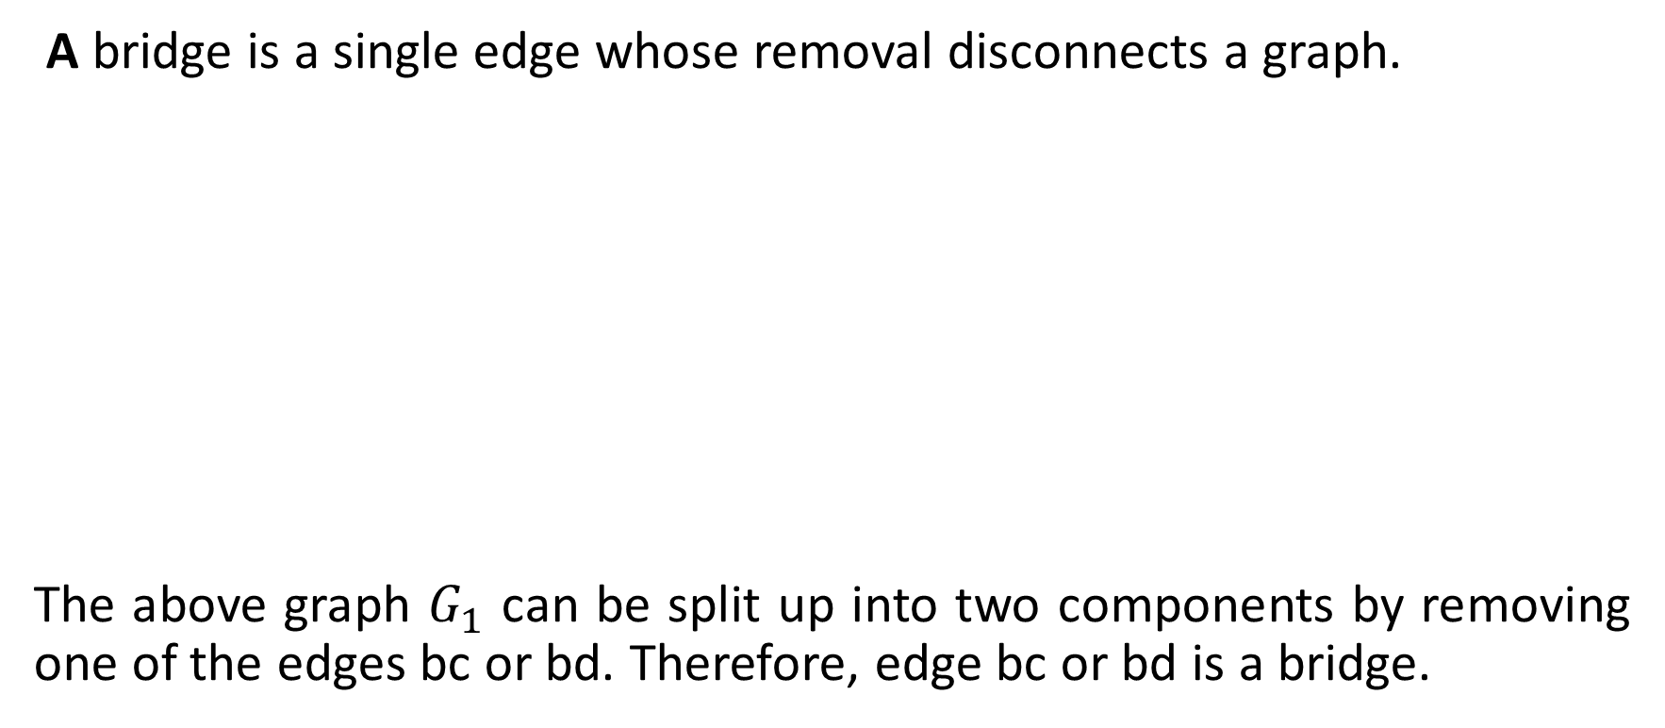
Cut Edge (Bridge)
A bridge is a single edge whose removal disconnects a graph.
The above graph $G_{1}$ can be split up into two components by removing one of the edges bc or bd. Therefore, edge bc or bd is a bridge.

Slide 11
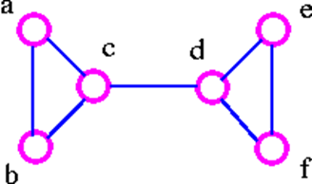
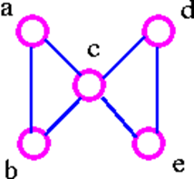

Continued…
The above graph $G_{2}$ can be disconnected by removing a single edge, cd. Therefore, edge cd is a bridge.

Slide 12
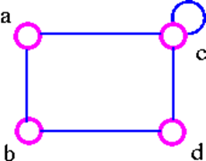

Continued…
The above graph $G_{3}$ cannot be disconnected by removing a single edge, but the removal of two edges (such as ac and bc) disconnects it.
The above graph $G_{4}$ can be disconnected by removing two edges such as ac and dc.

Slide 13
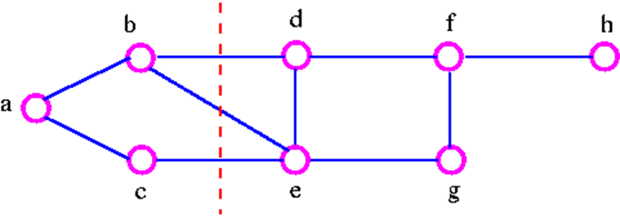
Cut set
A cut set of a connected graph G is a set S of edges with the following properties
The removal of all edges in S disconnects G.
The removal of some (but not all) of edges in S does not disconnects G.
As an example consider the following graph

Slide 14
Continued…
We can disconnect G by removing the three edges bd, bc, and ce, but we cannot disconnect it by removing just two of these edges. Note that a cut set is a set of edges in which no edge is redundant.
Cut-Vertex
A cut-vertex is a single vertex whose removal disconnects a graph.
It is important to note that the above definition breaks down if G is a complete graph, since we cannot then disconnect G by removing vertices. Therefore, we make the following definition.

Slide 15
Connectivity of Complete Graph
The connectivity k(k_{n}) of the complete graph k_{n} is n-1. When n-1 ≥ k, the graph k_{n} is said to be k-connected.
Vertex-Cut set
A vertex-cut set of a connected graph G is a set S of vertices with the following properties.
the removal of all the vertices in S disconnects G.
the removal of some (but not all) of vertices in S does not disconnects G.

Slide 16
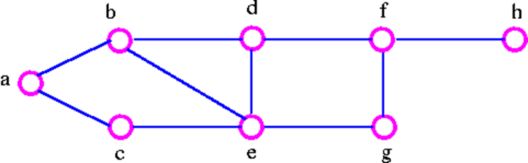
Continued…
Consider the following graph
We can disconnect the graph by removing the two vertices b and e, but we cannot disconnect it by removing just one of these vertices. the vertex-cut set of G is {b, e}.

Slide 17
Continued…
Note that the connectivity k(G) does not exceed the edge-connectivity λ(G). This inequality holds for all connected graph.
Formally, for any connected graph G we have
K(G) ≤ λ(G) ≤ δ(G)
where δ(G) is the smallest vertex-degree in G. But it is certainly possible for both inequalities in above theorem to be strict inequalities (that is, k(G) < λ(G) < δ(G)) For example, in the following graph,

Slide 18
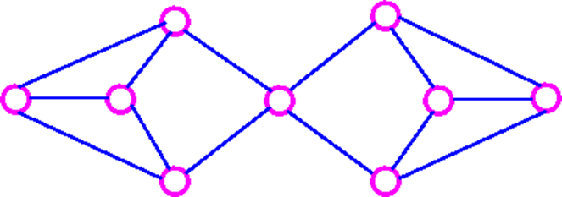
Continued…
K(G)=1, λ(G) = 2, and δ(G) = 3.

Slide 19


